Slide 1
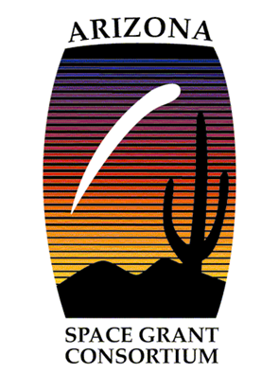
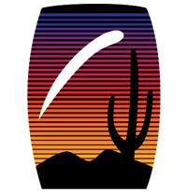
Effects of restoration treatments and forest type on soil microarthropod communities in Valles Caldera National Preserve
Channing Laturno
Dr. Anita Antoninka, Dr. Matthew Bowker, Kara Gibson
Northern Arizona University

Slide 2
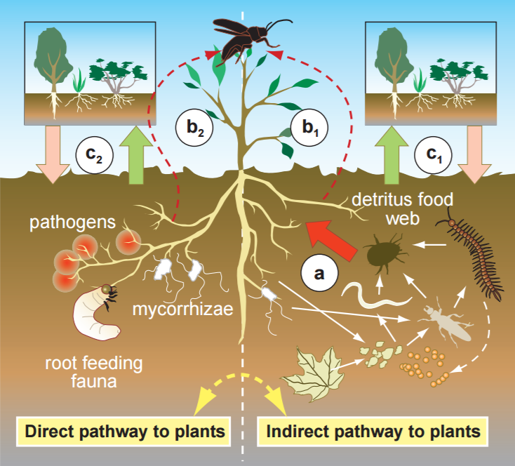
Microarthropods are soil animals that contribute to decomposition and nutrient cycling
Changes in soil communities may lead to altered ecosystem processes
Wardle et al. 2004

Slide 3
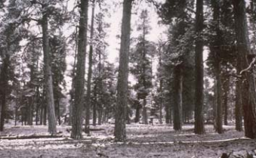
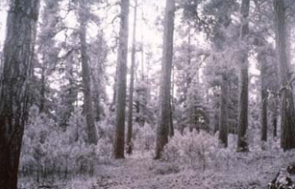
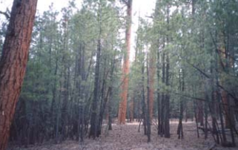
Southwest ponderosa pine forests are at risk
Restoration treatments are becoming more common
Treatment effects on soil ecosystem unknown
Southwest soil communities understudied
1908 (G. Pearson) 1938 (G. Pearson) 2000 (J. Waskiewicz)

Slide 4
Research Questions
1. What is the effect of restoration treatments on microarthropod abundance and diversity?
2. How do microarthropod communities vary between forest types?

Slide 5
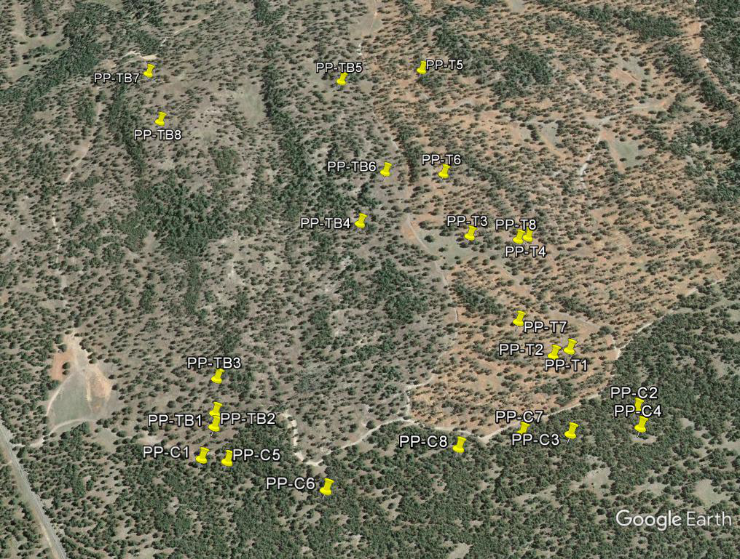
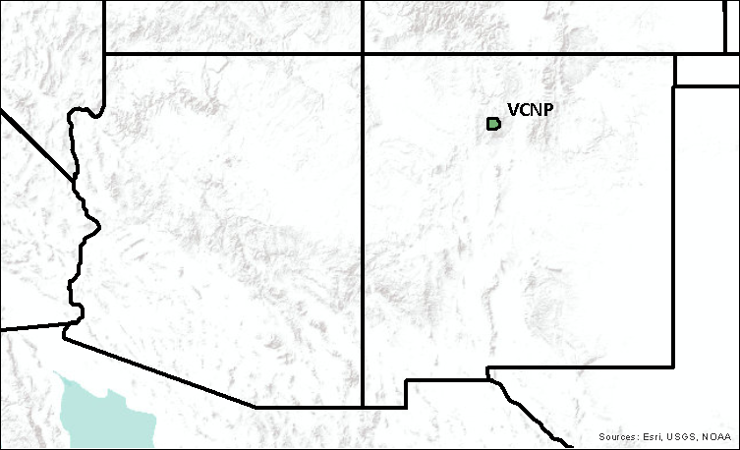
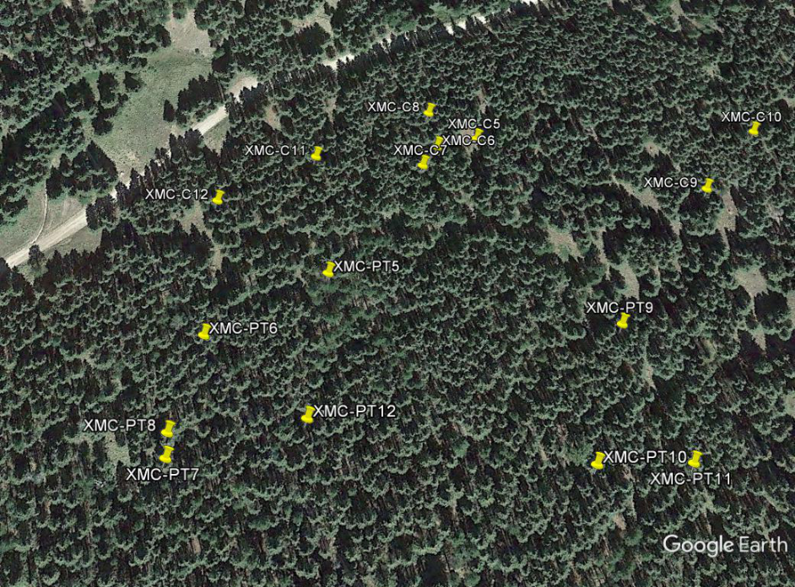
Sampling site: Valles Caldera National Preserve, NM
Notes:
west unit thinned jan-oct 2012, east unit thinned april-july 2014.
west burned oct 2015, east burned oct 2016.
Samples taken aug-sept 2016. Imagery is from June 2014. (the brown color in east unit is logging debris)

Slide 6
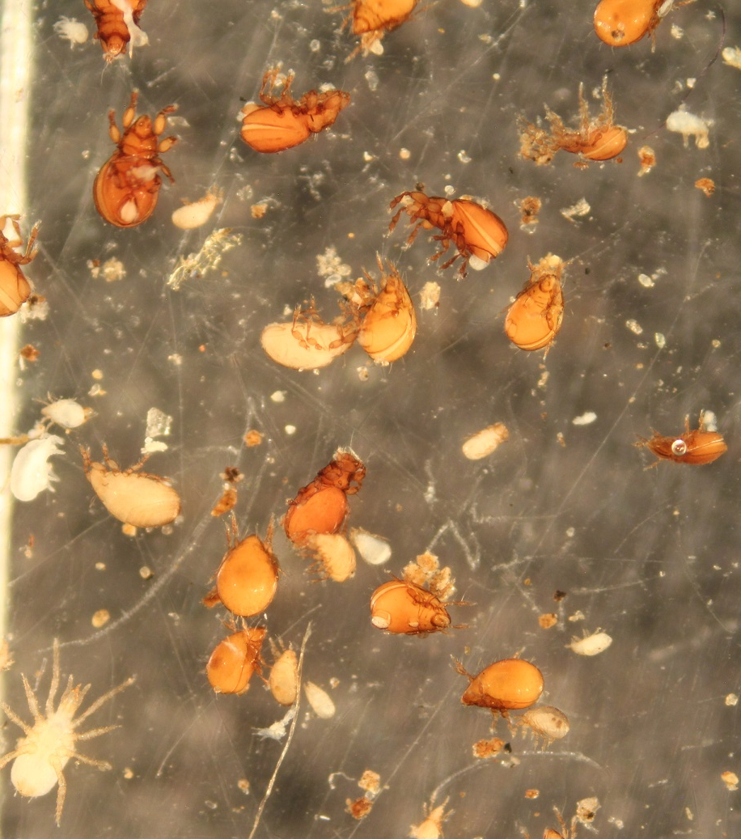
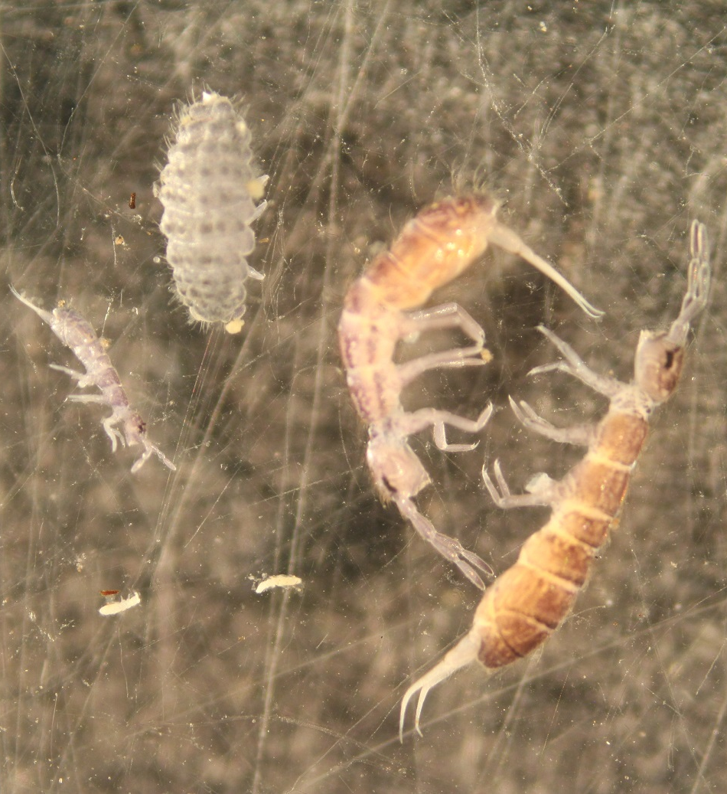
Mites
Collembola
~200 μm
~200 μm

Slide 7
Preliminary results: restoration treatments

Slide 8
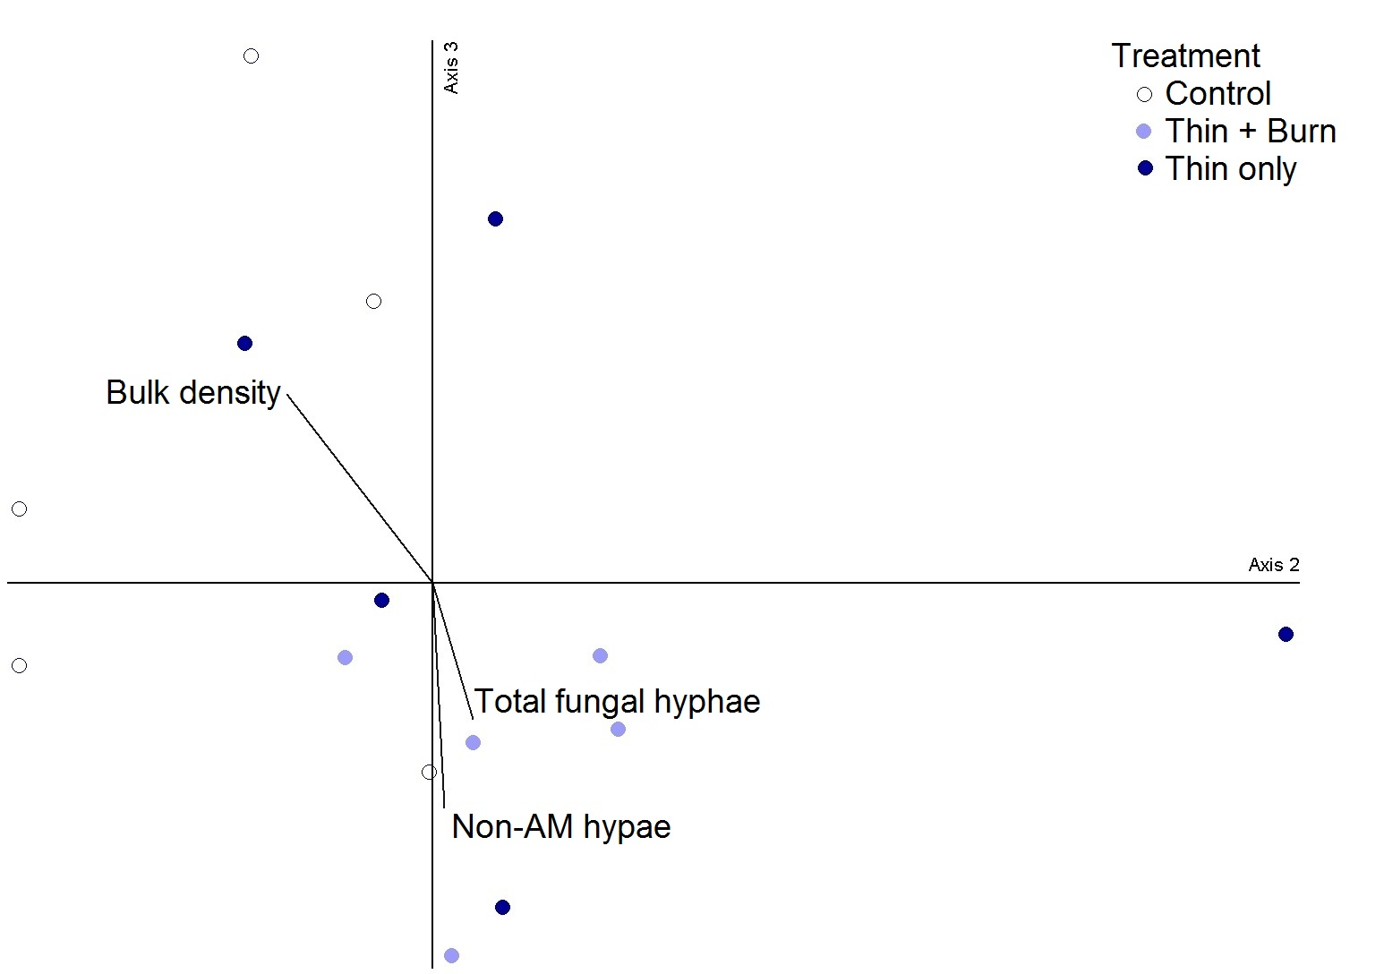
Preliminary results: restoration treatments

Slide 9
Preliminary results: forest type

Slide 10
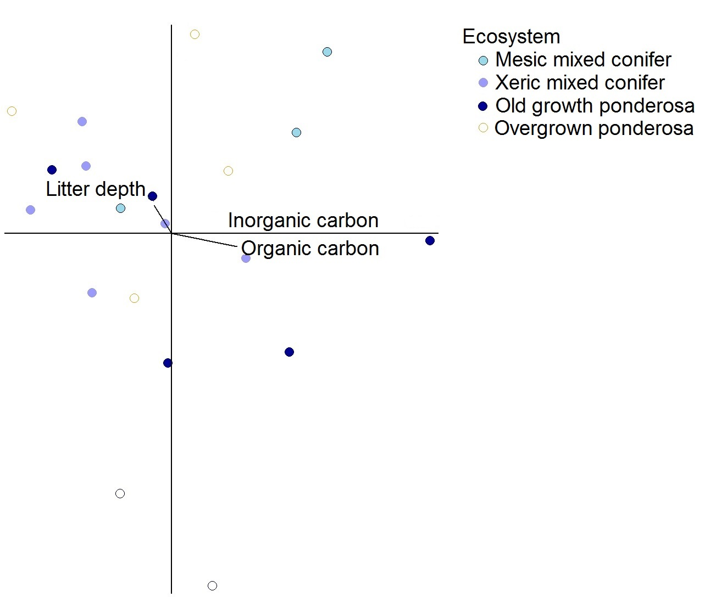
Preliminary results: forest type

Slide 11
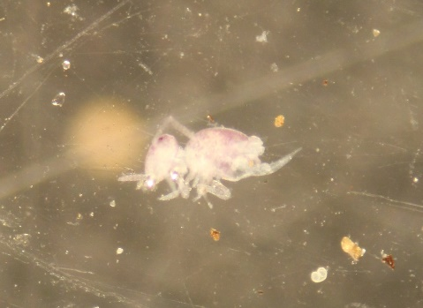
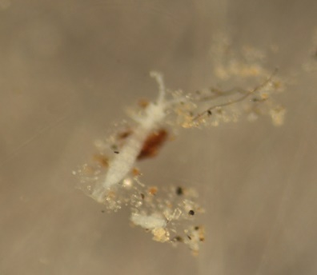
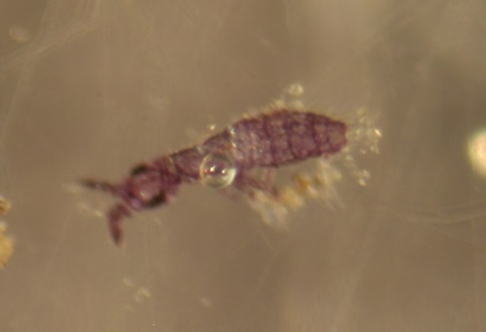
Conclusions
Preliminary results show no differences
Further analysis is expected to strengthen trends:
Thin and burn
Mesic mixed conifer
Better understanding the impacts of management activities on soil biota

Slide 12
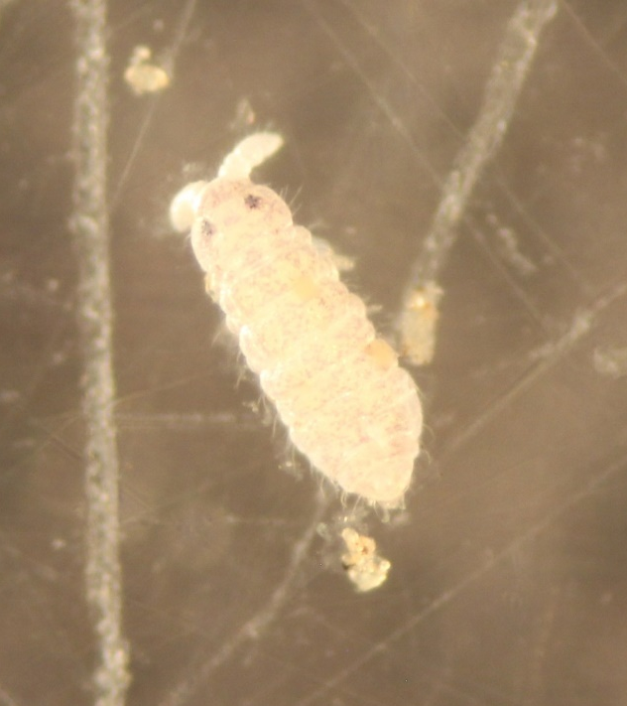
Acknowledgements
Dr. Anita Antoninka and Dr. Matthew Bowker
Kara Gibson
Matthew Ford, Dustin Kebble, Ryan Lancione, Jeff Propster, Andrea Raya, Aradhana Roberts, Michael Sloan, Zach Sumner
Valles Caldera National Preserve
Colorado Plateau Cooperative Ecosystem Studies Unit
NASA Space Grant Program

Slide 13
